Slide 1

Classes encapsulation
Presented by:
ATUL CHANDER SHARMA, IT ARCHITECT & subject matter consultant

Slide 2
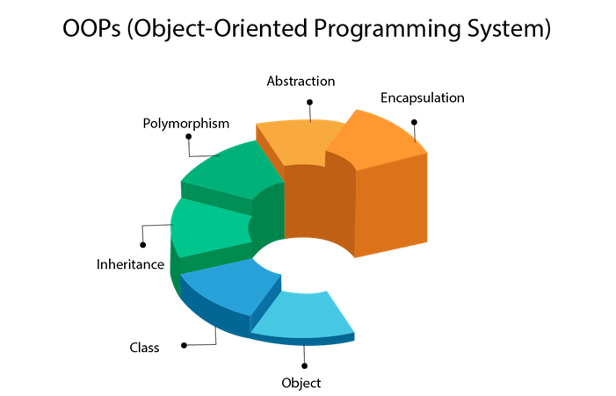


Slide 3
Popular approach to solve a programming problem is by creating objects is known as Object-Oriented Programming (OOP). An object has two characteristics: attributes behavior

Slide 4
Class A class is a blueprint for the object. Object An object (instance) is an instantiation of a class. When class is defined, only the description for the object is defined. Therefore, no memory or storage is allocated.

Slide 5
Encapsulation Using OOP, we can restrict access to methods and variables. This prevent data from direct modification which is called encapsulation. In we denote private attribute using underscore as prefix i.e single “ _ “ or double “ __“.

Slide 6
Polymorphism Polymorphism is an ability (in OOP) to use common interface for multiple form (data types).

Slide 7
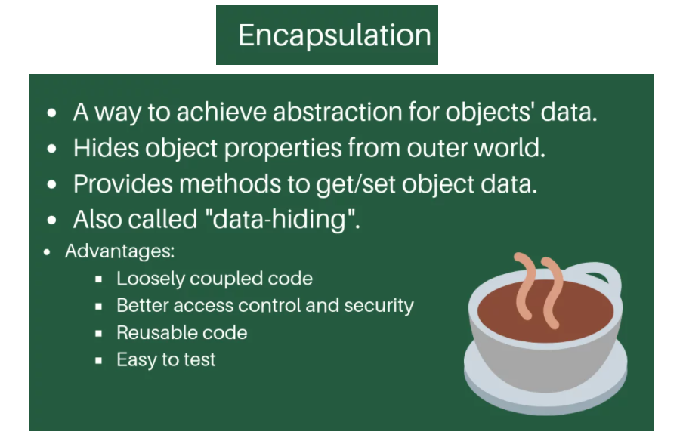

Slide 8
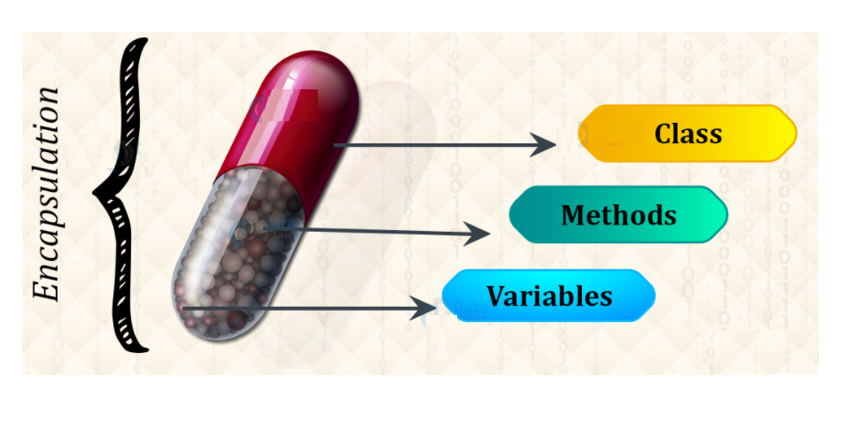

Slide 9
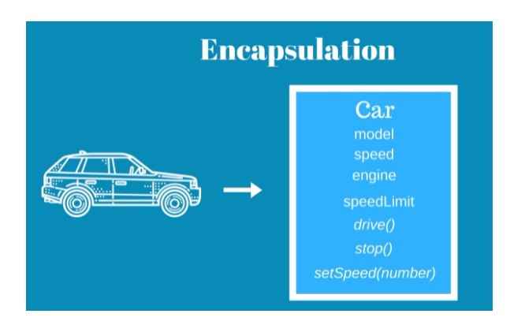

Slide 10
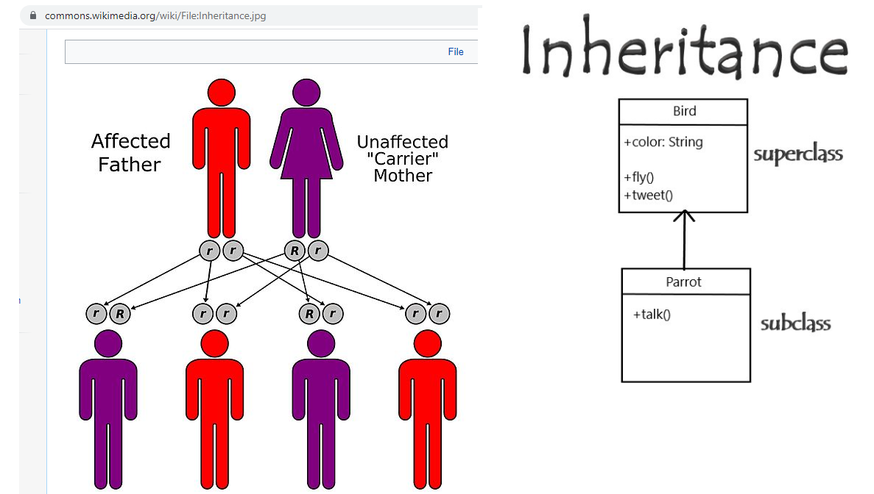

Slide 11
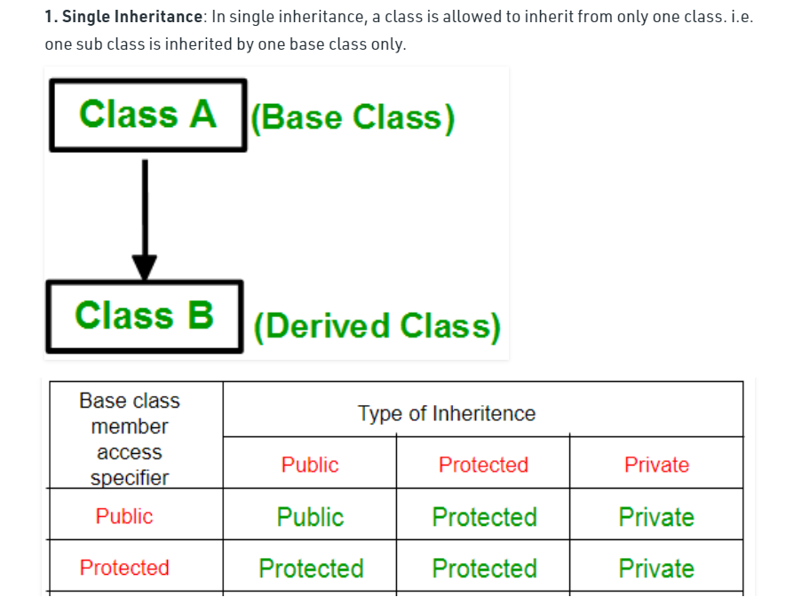

Slide 12
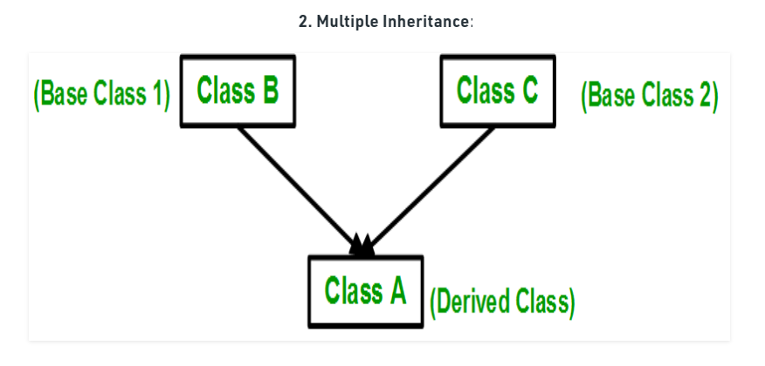

Slide 13
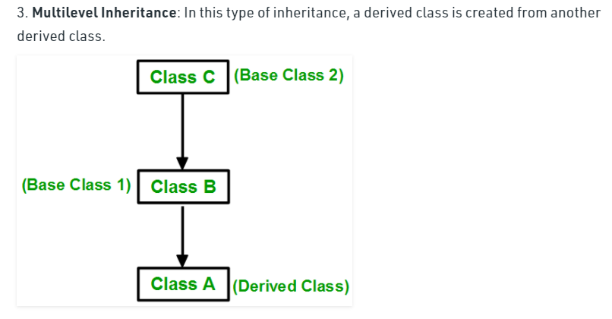

Slide 14
